Slide 1
Even when we proceed successfully from the psychiatric situation to a mechanistic explanation of disease, we face still another constraint: human agency.
Only a respectful and ethical acceptance of human agency will allow scientific reductionism to be successful in psychiatry.

Slide 2
Scientific reductionism in psychiatry
Psychiatric situation
Psychiatric diagnosis
Clinico-pathological correlation
Causal inference testing

Slide 3
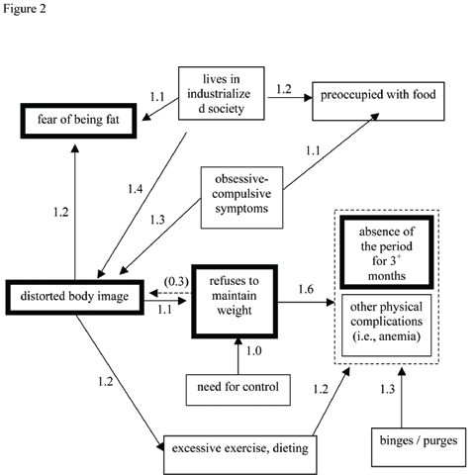
(From Ahn and Kim 2008)

Slide 4
‘What, then, defines a given individual experience e as a specific symptom, given that it is not pre-given as an autonomous, thing-like entity? On the phenomenological account, the symptom is individuated (becomes this or that symptom) along several dimensions, not only through its sheer content but also through its structure (form) and its meaning relations to previous, simultaneous, and succeeding experiences.’
(Nordgaard, Sass and Parnas 2013)

